Slide 1
Elements of C
UNIT 2

Slide 2
Character Set
Set of characters that are used to form words, numbers and expression in C is called c character set.
Characters in C are grouped into the following four categories:
Letters and alphabets (A…Z, a…z)
Digits (0,1,2,3,4,5,6,7,8,9)
Special Characters (, . ; : ? ‘ “ & ^ * - + < >)
White spaces (Blank Space, Horizontal tab etc)

Slide 3
Keywords
These are predefined words for a C programming language.
All keywords have fixed meaning and these meanings cannot be changed.
Ex.
auto | double | int | struct
Break | Else | Long | Switch
Case | Enum | Register | Typedef
Char | Return | Union | Const
Float | Short | Unsigned | Continue
Void | For | Default | Goto
Sizeof | Volatile | Do | If
Static | While | Extern | signed

Slide 4
Identifiers
Every word used in C program to identify the name of variables, functions, arrays, pointers and symbolic constants are known as identifiers.
Names given by user and consist of a sequence of letters and digits, with a letter as the first character. e.g. myVariable, myName, heyYou, callThisNumber45, add_this_number etc.
There are certain rules to be followed while naming identifiers. (KEEP THIS IN MIND)

Slide 5
Rules to be followed while naming identifiers
It must be a combination of letters and digits and must begin with a letter.
Underscore is permitted between two digits and must begin with a letter.
Only first 31 characters are significant.
Keywords cannot be used.
It is case sensitive, i.e. uppercase and lowercase letters are not interchangeable.

Slide 6
Data Types
10 is a whole number where as 100.5 is a fractional/rational number.
Similarly in C 10 is an integer number whereas 100.5 is a float number.
There are variety of data types available.
ANSI C supports three classes of data types:
Primary/fundamental data types
User-defined data types
Derived data types

Slide 7
Primary data types are categorized into five types:
Integer type (int)
Floating point type (float)
Double-precision floating point type (double)
Character type (char)
Void type (void)

Slide 8
Integer types
Integers are whole numbers
Requires 16 bit of storage. i.e. 2 bytes
Three classes of integer:
Integer (int)
Short integer (short int)
Long integer (long int)
Both signed and unsigned forms.
Defined as:
int a;
Int myVar=6;

Slide 9
Signed Integer | Unsigned Integer
It represents both positive and negative integers | It represents only positive integers
The data type qualifier is signed int or int. Variables are defined as: signed int a; Int b; | The data type qualifier is unsigned int or unsigned Variables are defined as: unsigned int a; unsigned b;
By default all int are signed | Unsigned int have to be declared explicitly
It reserves 16-bit (2 bytes) in memory | It reserves 16-bit (2 bytes) in memory
Range -2¹⁵ to +2¹⁵ i.e. -32,768 to 32,767 | Range from 0 to +2¹⁶ i.e. 0 to 65,535
Its conversion character is d | Its conversion character is u

Slide 10
Floating Point Types
Floating point types are fractional numbers
In C it is defined by float.
Reserves 32bits i.e. 4 bytes
Variable is defined as:
float a;
float myValue=56.5;

Slide 11
Assignment
Write something about Signed and Unsigned short Integers.
Write something about Signed and Unsigned long Integers.
Write something about Double Precision and Long Double Precision Floating point

Slide 12
Character Type
A single character can be defined as a character type data.
Stored in 8 bits (1 byte).
The qualifier signed or unsigned may be used with char.
The unsigned char has values between 0 and 255.
The signed char has values from -128 to 127.
The conversion character for this type is c

Slide 13
Each character is represented by an ASCII(American Standard code for information interchange)
Ex
“A” is represented by 65
“B” is represented by 66
“a” is represented by 97
“z” is represented by 122
With conversion character d, it will display ASCII value.
With conversion character c, it will display character.

Slide 14
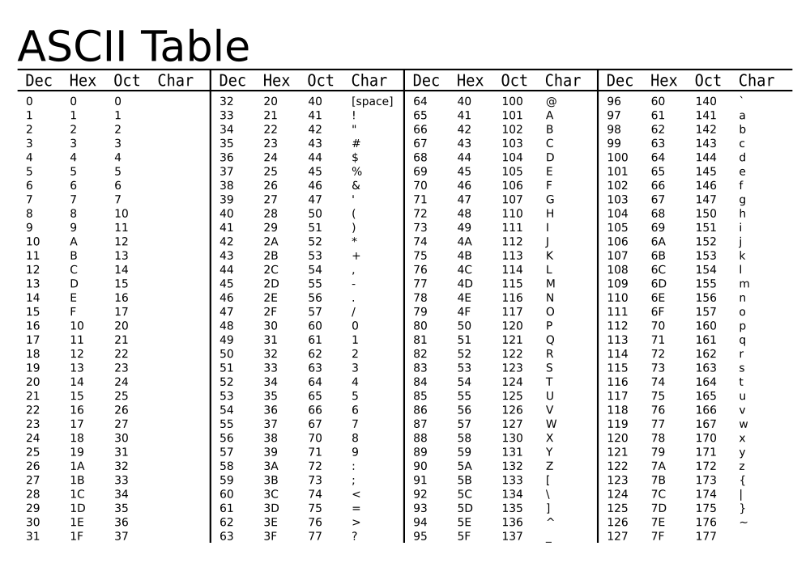

Slide 15
Note
The difference of corresponding uppercase and lowercase character is always 32.
i.e
ASCII value of ‘a’ – ASCII value of ‘A’ = 32
ASCII value of ‘m’ – ASCII value of ‘M’ = 32
Using this logic, we can convert uppercase letter into its lowercase and vice versa.

Slide 16
Void Type
This void type has no value.
This is usually used to specify a type of function when it does not return any value to the calling function.
Ex
void main()
void whatIsThis();

Slide 17
User Defined Data Types
C supports a feature called type definition which allows users to define an identifier that would represent an existing data type.
typedef statement is used to give new name to an existing data type.
It allows users to define new data types that are equivalent to an existing data types.

Slide 18
General form:
typedef existing_data_type new_name_for_existing_data_type;
Here,
existing_data_type is any one of the fundamental data type.
new_name_for_existing_data_type refers to a new identifier.
Ex:
typedef int integer;
integer symbolizes int data type. Now we can declare int variable “a” as “integer a” rather than “int a”

Slide 19
Constants
A constant is a quantity that doesn't change during the execution.
These fixed values are also called literals
Constants can be of any of the basic data types like an integer constant, a floating constant, a character constant, or a string literal. There are enumeration constants as well.

Slide 20
Integer Literals
An integer literal can be a decimal, octal, or hexadecimal constant.
A prefix specifies the base or radix: 0x or 0X for hexadecimal, 0 for octal, and nothing for decimal.
An integer literal can also have a suffix that is a combination of U and L, for unsigned and long, respectively.
Following are other examples of various types of integer literals −
85 | /* decimal */
0213 | /* octal */
0x4b | /* hexadecimal */
30 | /* int */
30l | /* long*/

Slide 21
Character Constants
Character literals are enclosed in single quotes,
e.g., 'x' can be stored in a simple variable of char type.
A character literal can be a
plain character (e.g., 'x'),
an escape sequence (e.g., '\t'),
or a universal character (e.g., '\u02C0').
There are certain characters in C that represent special meaning when preceded by a backslash for example, newline (\n) or tab (\t).

Slide 22
String Constants
Sequence of characters enclosed in double quotes.
May contain letters, numbers, special characters or blank spaces.
Eg.
“hello”
“hie”
“2048”

Slide 23
Variables
A symbolic name which is used to store data item i.e. a numerical quantity or a character constant.
Unlike constant, the value of a variable can change during the execution of a program.
The same variable can store different value at different portion of a program.
Variable name may consist of letters, digits or underscore characters.

Slide 24
Variable declaration
Any variable should be defined before using it in a program
Variable declaration syntax:
data-type variable_name1, variable_name2…..
Valid declaration are:
int n1;
int centi, temp;
float radius;
char gender;
n1 =1 | //valid
radius= 2.6 | //valid
gender =‘M’ | //valid
temp= ‘F’ | //Invalid

Slide 25
Rules for Variable Declaration
The variable name should start with only letters.
The variable name shouldn't not be keyword
White spaces are not allowed between characters of variable but underscores are approved
The variable name is case sensitive.
TEMP and temp is different variable
No two variables of the same name are allowed to be declared in the same scope

Slide 26
Preprocessor Directives
Collection of special statements that are executed at the beginning of a compilation process.
Placed in the source program before the main function.
These statements are called preprocessor directives as they are processed before compilation of any other source code in the program.
#include<stdio.h> | //used for file inclusion
#define PI 3.1416 | //defining symbolic constant PI
#define TRUE 1 | //used for defining TRUE as 1
#define FLASE 0 | //used for defining FALSE as 0

Slide 27
Escape sequences
An escape sequence is a non-printing characters used in C.
Character combination consisting of backslash (\) followed by a letter or by a combination of digits.
Each sequences are typically used to specify actions such as carriage return, backspace, line feed or move cursors to next line.

Slide 28
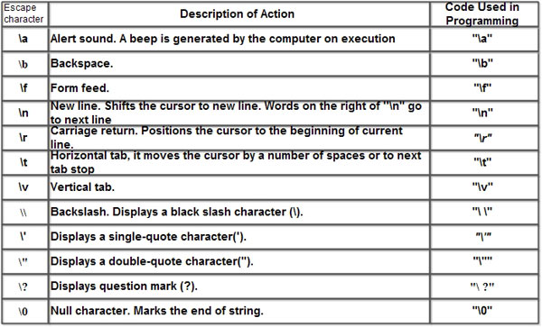

Slide 29
#include<stdio.h>
#include<conio.h>
Void main(){
printf(“Hello! \n I am testing an escape sequence”);
getch();
}
OUTPUT:
Hello!
I am testing an escape sequence.

Slide 30
#include<stdio.h>
#include<conio.h>
Void main(){
printf(“Hello \t World \n”);
printf(“He said, \”hello\””);
}
OUTPUTS:
Hello World
He said, “Hello”

Slide 31
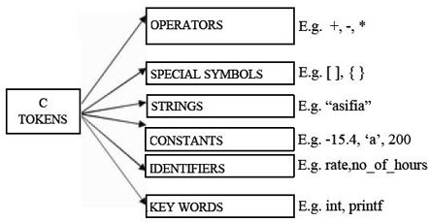
Tokens in C
The basic elements recognized by the C compiler are the “tokens”

Slide 32
Delimiters
A delimiter is a unique character or series of characters that indicates the beginning or end of a specific statement, string or function body set.
Delimiter examples include:
Round brackets or parentheses: ( )
Curly brackets: { }
Escape sequence or comments: /*
Double quotes for defining string literals: " "

Slide 33
Expressions
In programming, an expression is any legal combination of symbols that represents a value.
For example, in the C language x+5 is a legal expression.
Every expression consists of at least one operand and can have one or more operators.
Operands are values and Operators are symbols that represent particular actions.
Ex:
in the C language x+5 is a legal expression.

Slide 34
Types of Expression
Type | Explanation | Example
Infix | Expression in which Operator is in between Operands | a + b
Prefix | Expression in which Operator is written before Operands | + a b
Postfix | Expression in which Operator is written after Operands | a b +

Slide 35
Example: Expression
Infix | Postfix | Prefix | Notes
A * B + C / D | A B * C D / + | + * A B / C D | multiply A and B, divide C by D, add the results
A * (B + C) / D | A B C + * D / | / * A + B C D | add B and C, multiply by A, divide by D
A * (B + C / D) | A B C D / + * | * A + B / C D | divide C by D, add B, multiply by A

Slide 36
ASSIGNMENT
Write something about Real Constants and also fractional form constants and exponential form constants(mantissa/exponents).
Write something about Symbolic Constants. Write rules for defining a symbolic constants. Also explain advantages of symbolic constants.

Slide 37
END

